Slide 1
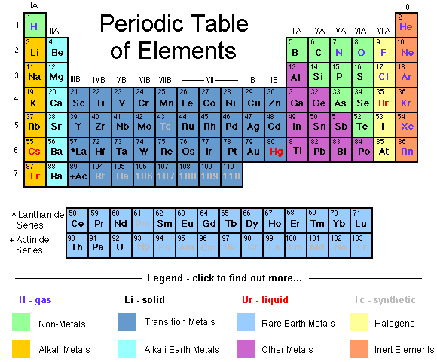

Slide 2
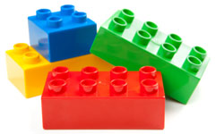
The Elements
Elements are like Lego Blocks for the universe
The Periodic Table lists all of the different kinds of Elements

Slide 3
Colouring Instructions
You may use different colours than those displayed
But make sure you keep the same groupings
Outline (instead of colouring in) to save time
A legend is absolutely required

